Slide 1
PH201: Recitation
Week 5
Notes:
Incline planes: Monday
Coupled systems: Monday
Pulley’s and mechanical advantage: Thursday
Uniform circular motion: Thursday

Slide 2
Forces and Free Body Diagrams
Newton’s 2nd law: $\sum{{\overset{⃑}{F}}_{ext}}=\left(m_{sys}\right)\left({\overset{⃑}{a}}_{CoM}\right)$
A Free Body Diagram (FBD) is a visual representation of Newton’s 2nd law.
A Free Body Diagram should indicate
Direction of net force and hence the acceleration of the center of mass
A Free Body Diagram should include
All forces needed to represent the direction of net force accurately.
Force notation used will include both superscripts and subscripts. For example
${\overset{⃑}{F}}_{12}^{N}$ is interpreted as the “Normal” force of object 1 acting on object 2.

Slide 3
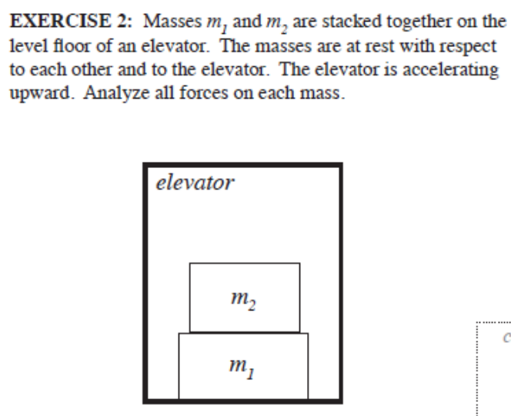
Dissecting FBD’s

Slide 4
Dissecting Free Body Diagrams
Identify the forces acting and their directions for the given object in each situation, and then construct the FBD for the given object
A baseball player is sliding into second base.
A jet plane is speeding down the runway during takeoff (Do not ignore air resistance).
You slam on your breaks while driving to avoid hitting the car in front of you. What are the forces acting on your car?
You pinch a book between your thumb and fore finger, holding the book so it doesn’t slide to the floor.

Slide 5
Friction: Both Static and Kinetic
${\overset{⃑}{F}}^{f_{k}}=μ_{k}{\overset{⃑}{F}}^{N}$
Always true for objects sliding under the influence of friction
${\overset{⃑}{F}}^{f_{s}}=μ_{s}{\overset{⃑}{F}}^{N}$
Only true for the case of maximum force of static friction!!!
This is the case where if the force of friction were slightly greater the object would slide under the influence of kinetic friction.

Slide 6
Friction
A 1000 kg car traveling at a speed of 40 m/s skids to halt on wet concrete where $μ_{k}=0.60$. How long are the skid marks?
Challenge: How far would the car have travelled if the breaks were applied at the limit of skidding (Such that if the breaks were applied with a little more pressure the car would skid) ($μ_{s}=0.65$)?
If the coefficient of friction between your fingers and a 1 kg book is $μ_{s}=0.80$, what is the minimum force you can pinch with in order to keep the book from sliding between your fingers?

Slide 7
Problem 1

Slide 8
Problem 1

Slide 9
Problem 1

Slide 10
Problem 1

Slide 11
Problem 1 Challenge

Slide 12
Problem 2

