Slide 1
PH201: Recitation
Week 3
Notes:
Next Week: 1D Kinematics on Tuesday
2D Kinematics on Thursday (Not all projectile motion)

Slide 2
Example Problem
A simple model for a person running the 100m dash is to assume the sprinter runs with constant acceleration until reaching top speed, then maintains that speed through the finish line. If a sprinter reaches their top speed of 11.2 m/s in 2.14s. What will be their total time?

Slide 3
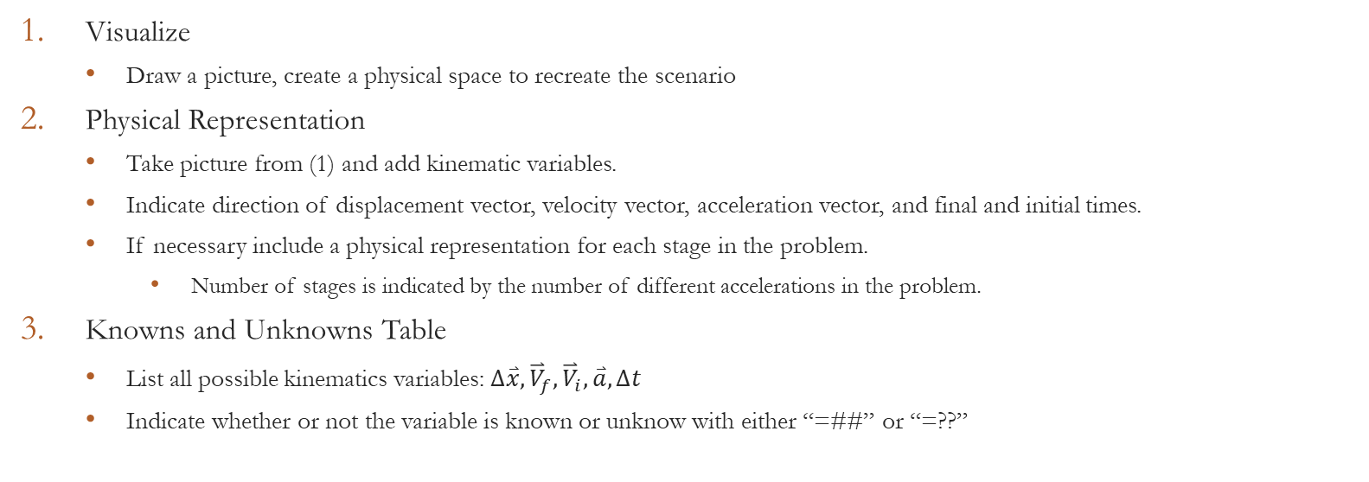
Recipe: Solving Kinematics Problems
Visualize
  Draw a picture, create a physical space to recreate the scenario
Physical Representation
  Take picture from (1) and add kinematic variables.
  Indicate direction of displacement vector, velocity vector, acceleration vector, and final and initial times.
  If necessary include a physical representation for each stage in the problem.
    Number of stages is indicated by the number of different accelerations in the problem.
Knowns and Unknowns Table
  List all possible kinematics variables: $∆\overset{⃑}{x}, {\overset{⃑}{V}}_{f},{\overset{⃑}{V}}_{i},\overset{⃑}{a}, ∆t$
  Indicate whether or not the variable is known or unknow with either “=##” or “=??”

Slide 4
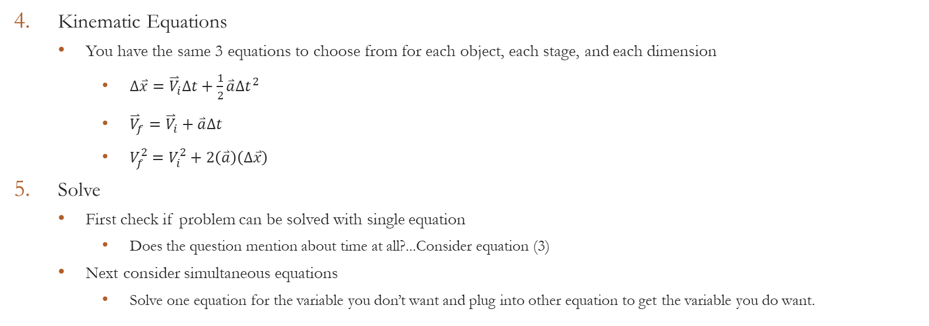
Recipe: Solving Kinematics Problems
Kinematic Equations
  You have the same 3 equations to choose from for each object, each stage, and each dimension
    $∆\overset{⃑}{x}={\overset{⃑}{V}}_{i}∆t+\frac{1}{2}\overset{⃑}{a}∆t^{2}$
    ${\overset{⃑}{V}}_{f}={\overset{⃑}{V}}_{i}+\overset{⃑}{a}∆t$
    $V_{f}^{2}=V_{i}^{2}+2\left(\overset{⃑}{a}\right)\left(∆\overset{⃑}{x}\right)$
Solve
  First check if problem can be solved with single equation
    Does the question mention about time at all?...Consider equation (3)
  Next consider simultaneous equations
    Solve one equation for the variable you don’t want and plug into other equation to get the variable you do want.

Slide 5
Example Problem
A simple model for a person running the 100m dash is to assume the sprinter runs with constant acceleration until reaching top speed, then maintains that speed through the finish line. If a sprinter reaches their top speed of 11.2 m/s in 2.14s. What will be their total time?

Slide 6
Recipe: Solving Kinematics Problems
Visualize
  Draw a picture, create a physical space to recreate the scenario
Physical Representation
  Take picture from (1) and add kinematic variables.
  Indicate direction of displacement vector, velocity vector, acceleration vector, and final and initial times.
  If necessary include a physical representation for each stage in the problem.
    Number of stages is indicated by the number of different accelerations in the problem.
Knowns and Unknowns Table
  List all possible kinematics variables: $∆\overset{⃑}{x}, {\overset{⃑}{V}}_{f},{\overset{⃑}{V}}_{i},\overset{⃑}{a}, ∆t$
  Indicate whether or not the variable is known or unknow with either “=##” or “=??”

Slide 7


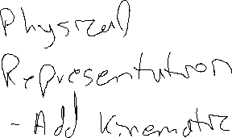








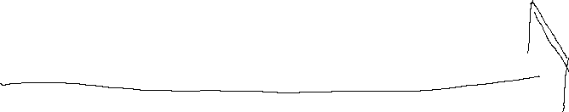
Example Problem

Slide 8
Recipe: Solving Kinematics Problems
Visualize
  Draw a picture, create a physical space to recreate the scenario
Physical Representation
  Take picture from (1) and add kinematic variables.
  Indicate direction of displacement vector, velocity vector, acceleration vector, and final and initial times.
  If necessary include a physical representation for each stage in the problem.
    Number of stages is indicated by the number of different accelerations in the problem.
Knowns and Unknowns Table
  List all possible kinematics variables: $∆\overset{⃑}{x}, {\overset{⃑}{V}}_{f},{\overset{⃑}{V}}_{i},\overset{⃑}{a}, ∆t$
  Indicate whether or not the variable is known or unknow with either “=##” or “=??”

Slide 9
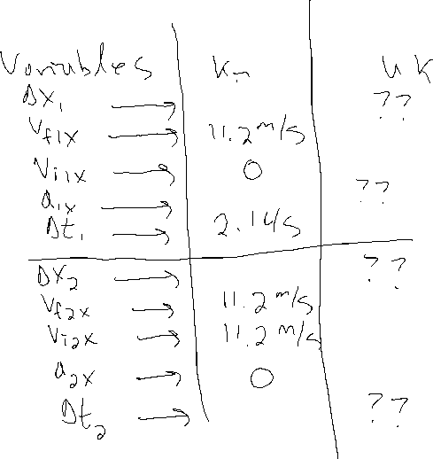


Example Problem
A simple model for a person running the 100m dash is to assume the sprinter runs with constant acceleration until reaching top speed, then maintains that speed through the finish line. If a sprinter reaches their top speed of 11.2 m/s in 2.14s. What will be their total time?

Slide 10
Recipe: Solving Kinematics Problems
Kinematic Equations
  You have the same 3 equations to choose from for each object, each stage, and each dimension
    $∆\overset{⃑}{x}={\overset{⃑}{V}}_{i}∆t+\frac{1}{2}\overset{⃑}{a}∆t^{2}$
    ${\overset{⃑}{V}}_{f}={\overset{⃑}{V}}_{i}+\overset{⃑}{a}∆t$
    $V_{f}^{2}=V_{i}^{2}+2\left(\overset{⃑}{a}\right)\left(∆\overset{⃑}{x}\right)$
Solve
  First check if problem can be solved with single equation
    Does the question mention about time at all?...Consider equation (3)
  Next consider simultaneous equations
    Solve one equation for the variable you don’t want and plug into other equation to get the variable you do want.

Slide 11



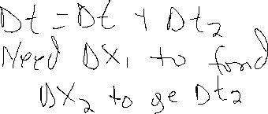




Example Problem

Slide 12
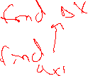




Example Problem

Slide 13
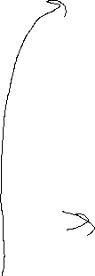








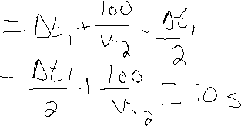

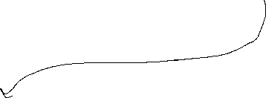
















Example Problem

Slide 14
Example Problems
A light-rail train going from one station to the next on a straight section of track accelerates from rest at 1.1m/s/s for 20s. It then proceeds at a constant speed for 1100m before slowing down at 2.2m/s/s until it stops.
  What is the distance between the stations?
  How much time does it take the train to go between the stations?
You and your friend decide it would be fun to play catch on the side of a hill, with you standing at the top of the hill throwing the ball down to your friend on the side of the hill. The hill has a slope of 15° made with respect to the horizontal. If you throw the ball with a speed of 15 m/s at an angle of 30°, how far down the hill should your friend stand in order to catch the ball?

