Slide 1
PH201 Recitation
10.05.17

Slide 2
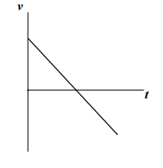
Problem 1
Draw the velocity vs. time plot for an object thrown into the air with some speed and coming back down to the same height

Slide 3
Problem 2
Sally hears a loud buzzing sound coming towards her. She grabs her fly swatter and hits a gigantic fly going 96 mi/hr, sending it in the opposite direction at 56 mi/hr. The contact between the fly and the swatter is 0.75 milliseconds. What is the average acceleration of the fly during the contact with the fly swatter? Express your answer in m/s²
a = 9000 m/s²

Slide 4
Problem 3
Superman is standing in a window of a building 100ft above the street. A baby hurtles past, having fallen from a window 50 ft higher. With what acceleration must Superman descend to catch the baby just before its too late?
a = 56.5 m/s²

Slide 5
Questions??

