Slide 1
PH201: Recitation
Week 2

Slide 2
Position, Velocity and Acceleration

Slide 3
Position, Velocity, and Acceleration

Slide 4
Position, Velocity, and Acceleration
Two balls are released from rest and undergo free-fall. Ball A is released first, followed by ball B a time T₀ later. The distance between the balls follows the following function of the change in time (Δt).
where g is the magnitude of the acceleration of gravity. How does the distance change with respect to the change in time?

Slide 5
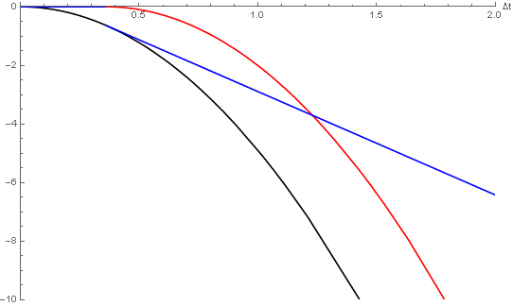
Position, Velocity, and Acceleration

Slide 6
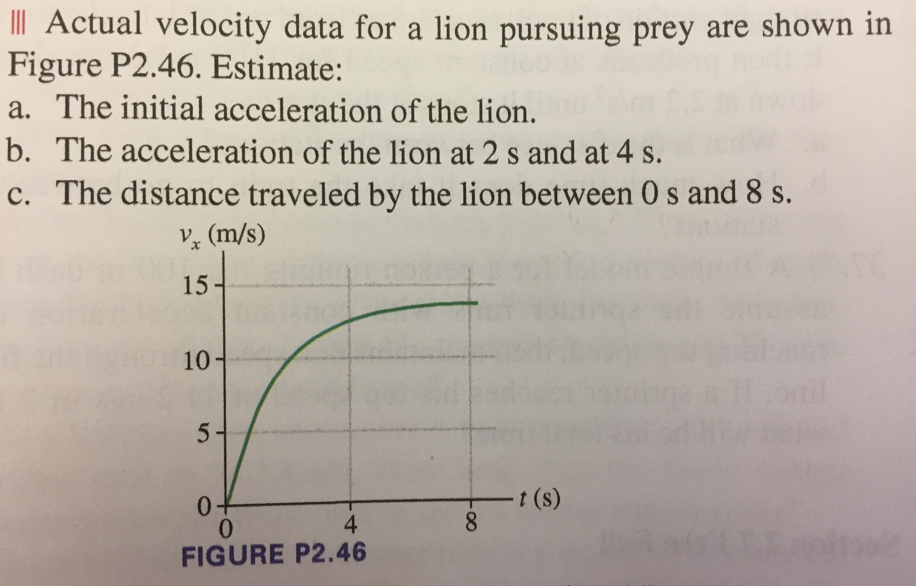
Example Problems
c. Construct both the velocity vs time and acceleration vs time plots.
d. Construct both the position vs time and acceleration vs time plots.

Slide 7
Example Problems
A skier is gliding along at 3 m/s on horizontal, frictionless snow. Then suddenly starts down a 10 degree incline. The skier’s speed at the bottom is 15 m/s (hint a=gsinθ)
What is the length of the incline?
How long does it taken the skier to reach the bottom of the incline?
Ships A and B leave port together. For the next two hours, ship A travels 20 mph in a direction 30 degrees west of north while ship B travels 20 degrees east of north at 25 mph
What is the distance between the two ships two hours after they depart?
What is the speed of ship A as seen from ship B?
Notes:
Day 1: graphical position velocity acceleration; Average velocity, average acceleration (see lecture problems).
Day 2: graphical position velocity acceleration; easy kinematics.

