Slide 1
PH201 Recitation
10/03/17

Slide 2
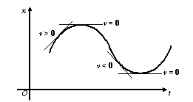
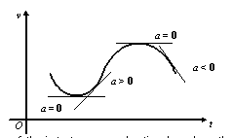
Graphical Representation of Kinematics:
Position ⟹ velocity, velocity ⟹ acceleration

Slide 3
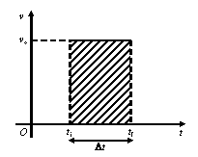
Graphical Representation of Kinematics:
acceleration ⟹ velocity, velocity ⟹ position

Slide 4
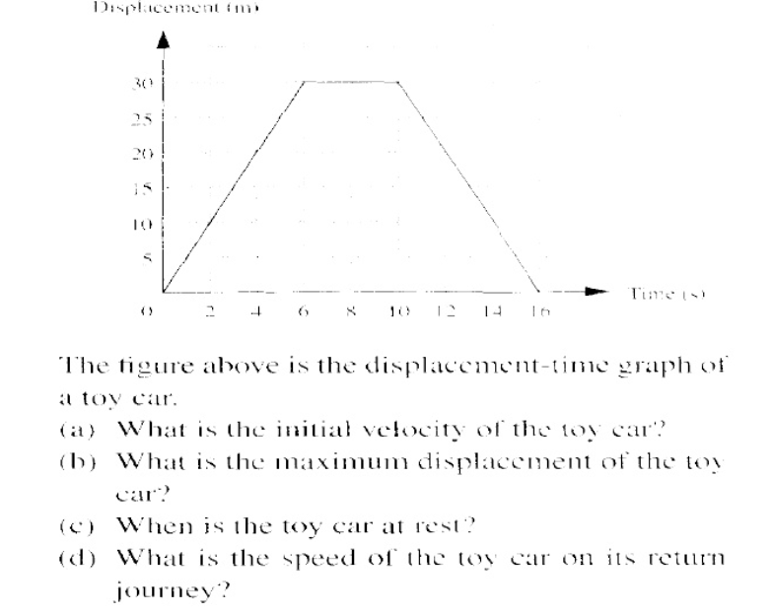
Problem 1
Notes:
a) 5 m/s b)30m c)6-10 s d)5 m/s

Slide 5
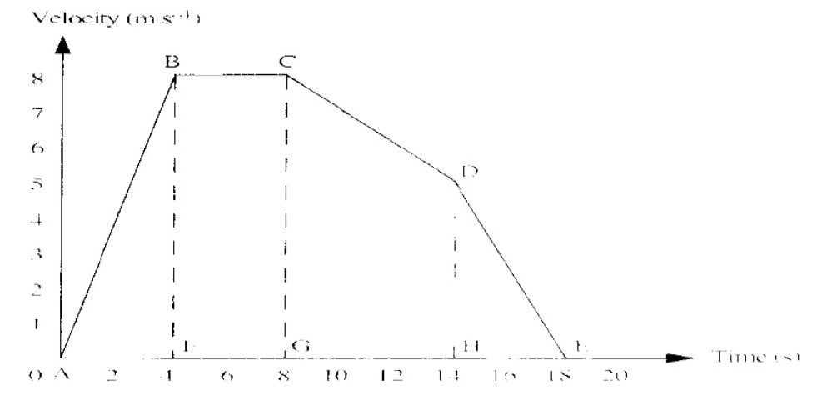
Problem 2
Notes:
a) Initial acceleration? B)distance traveled before max velocity reached? C)total distance traveled d) average speed? E) minimum acceleration?

Slide 6
HW questions??

