Slide 1
PH202 Midterm 1 Review
Rotational Kinematics, Torque, Angular Momentum and Rotational Kinetic Energy

Slide 2
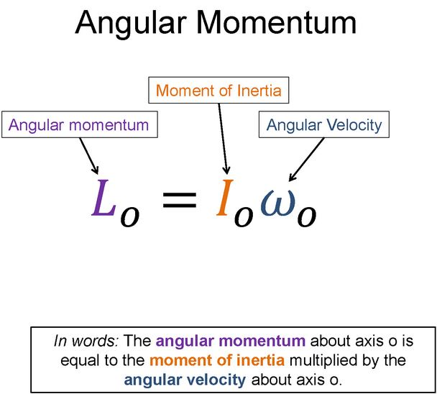
Warm-Up 1: 1 minute
Say this equation in words

Slide 3
Warm-Up 1 Solution

Slide 4
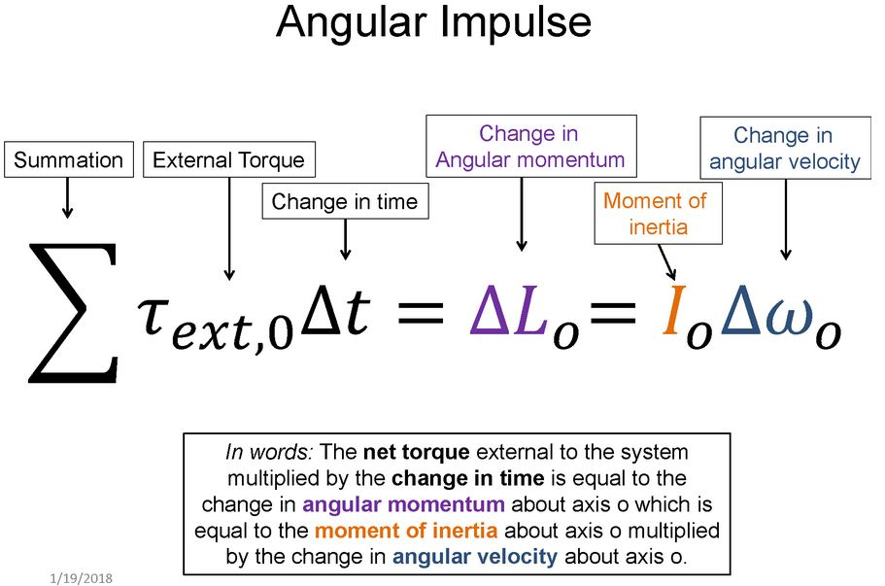
Warm-Up 2: 1 minute
Say the equation in words

Slide 5
Warm-Up 2 Solution

Slide 6
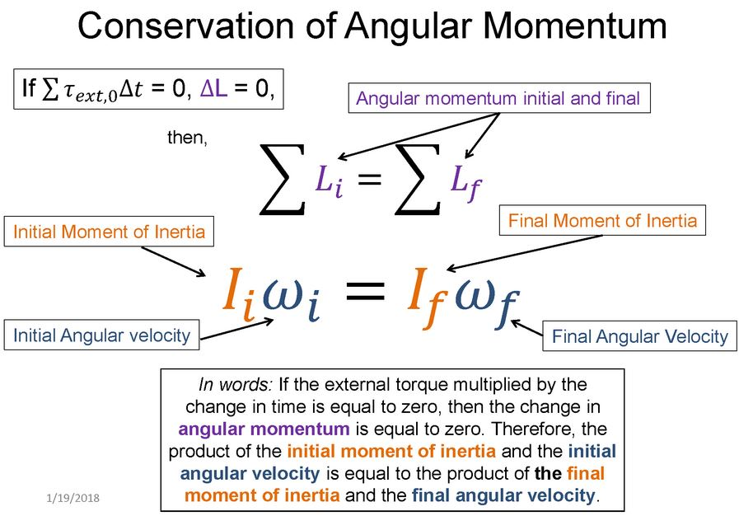
Warm-Up 3: 1 minute
Say the equation in words

Slide 7
Warm-Up 3 Solution

Slide 8
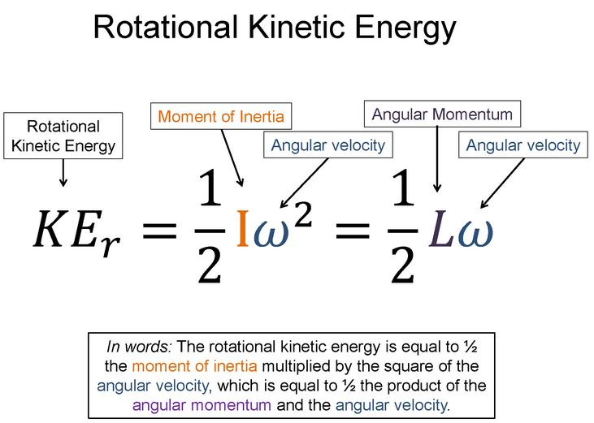
Warm-Up 4: 1 minute
Say the equation in words

Slide 9
Warm-Up 4 Solution

Slide 10
Discussion Question 1: 3 minutes
A small mass is placed on a record turntable that is rotating at 45rpm. The linear acceleration of the mass is
  Directed perpendicular to the line joining the mass and the center of rotation
  Independent of the position of the mass on the turntable
  Greater the closer the mass is to the center
  Greater the farther the mass is from the center
  Zero

Slide 11
Discussion Question 2: 3 minutes
A hoop, a solid cylinder, a spherical shell, and a solid sphere are placed at rest at the top of an incline. All the objects have the same mass and radius. They are then released at the same time. What is the order in which they reach the bottom of the incline? Justify your answer.

Slide 12
Discussion Question 3: 3 minutes
A well oiled merry-go-round (horizontal disk) is rotating with a girl walking from the outside edge towards the middle. Which of the following statements are true regarding this situation?
  The rotational velocity of the girl+merry-go-round system remains constant
  The rotational velocity of the girl increases
  The angular momentum of the merry-go-round increases
  The angular momentum of the girl+merry-go-round system increases
  The kinetic energy of the girl+merry-go-round system increases
  The kinetic energy of the girl+merry-go-round system remains constant

Slide 13
POTD: Read/Visualize the Problem: 2 minutes
I have a rod of mass 10kg (uniformly distributed) that has a length of 1m and is aligned vertically, and is bolted at the top end of the rod. 3 forces are acting on the rod. F₁ = 25N and is perpendicular to the rod acting at the halfway point of the rod and pushing the rod to the left. F₂ = 10N, is acting ¾ of the length of the rod from the pivot point pulling the rod to the right and the angle between the 2 vectors is 30 degrees. F₃ = 15N, is acting at the end of the rod away from the pivot point, pushing the rod to right and is perpendicular to the rod. If I = 1/3 ML² for a rod pivoting about an end, what is the angular acceleration of the rod?

Slide 14
POTD: Draw a Picture and Knowns/Unknowns: 2 minutes
I have a rod of mass 10kg (uniformly distributed) that has a length of 1m and is aligned vertically, and is bolted at the top end of the rod. 3 forces are acting on the rod. F₁ = 25N and is perpendicular to the rod acting at the halfway point of the rod and pushing the rod to the left. F₂ = 10N, is acting ¾ of the length of the rod from the pivot point pulling the rod to the right and the angle between the 2 vectors is 30 degrees. F₃ = 15N, is acting at the end of the rod away from the pivot point, pushing the rod to right and is perpendicular to the rod. If I = 1/3 ML² for a rod pivoting about an end, what is the angular acceleration of the rod?

Slide 15
POTD: Solve the problem: 10 minutes
I have a rod of mass 10kg (uniformly distributed) that has a length of 1m and is aligned vertically, and is bolted at the top end of the rod. 3 forces are acting on the rod. F₁ = 25N and is perpendicular to the rod acting at the halfway point of the rod and pushing the rod to the left. F₂ = 10N, is acting ¾ of the length of the rod from the pivot point pulling the rod to the right and the angle between the 2 vectors is 30 degrees. F₃ = 15N, is acting at the end of the rod away from the pivot point, pushing the rod to right and is perpendicular to the rod. If I = 1/3 ML² for a rod pivoting about an end, what is the angular acceleration of the rod?

