Slide 1
PH202 Recitation 1
Rotational Kinematics

Slide 2
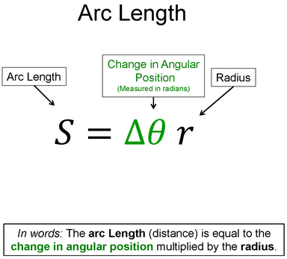
Warm-Up 1
Say this equation in words

Slide 3
Warm-Up 1 Solution

Slide 4

Warm-Up 2
Say the equation in words

Slide 5
Warm-Up 2 Solution
Change in Angular Position
Change in Time squared
Change in Time
Initial Angular Velocity
Angular Acceleration
In words: The change in angular position is equal to the product of the initial angular velocity and the change in time plus one half the product of the angular acceleration and the change in time squared.

Slide 6
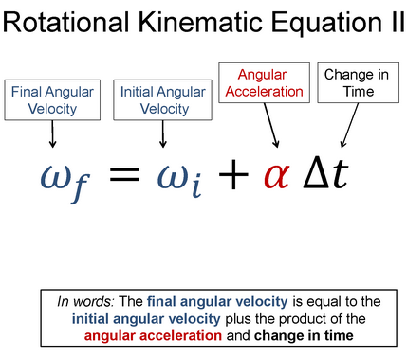
Warm-Up 3
Say the equation in words

Slide 7
Warm-Up 3 Solution

Slide 8
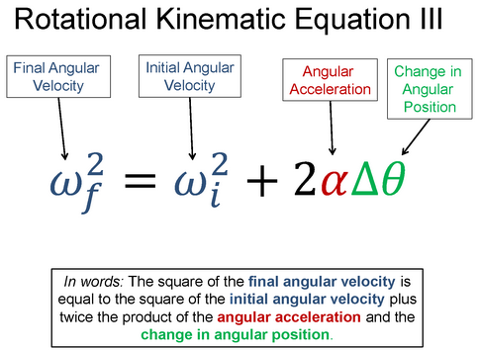
Warm-Up 4
Say the equation in words

Slide 9
Warm-Up 4 Solution

Slide 10
Discussion Question 1: 3 minutes
The earth rotates once per day about its axis. Where on earth’s surface should you stand in order to have the smallest possible tangential speed? Where would you stand in order to have the largest possible tangential speed? Why?

Slide 11
Discussion Question 2: 3 minutes
2 points are located on a rigid wheel that is rotating with a decreasing angular velocity about a fixed axis. Point A is located on the rim of the wheel and point B is half-way between the rim and the axis. Which of the following statements are true concerning this situation?
  Both points have the same radial acceleration
  Both points have the same tangential acceleration
  The angular velocity at point A is greater than that of point B
  Each second, point A turns through a greater angle than point B

Slide 12
Question 1: 7 minutes
You put your favorite CD into a CD player to listen to some music as you do your Challenge Homework.
  If your CD (radius = 6cm) speeds up to a speed of 3600 revolutions per minute in 4s, what is the angular acceleration of the CD?
  How far did a point on the edge of the CD travel during that 4s?
  If the CD takes 6s to come to rest, what is the angular acceleration of the CD?

Slide 13
Question 2: 7 minutes
At time t = 0, a wheel is rotating about it’s axis with an angular velocity of 2 rad/s and is constantly accelerating. 2 seconds later the wheel has completed 5 revolutions. What is the angular velocity of the wheel after the 2 seconds?

Slide 14


Question 3: 7 minutes
A lacrosse ball is thrown by rotating the stick through 90 degrees and then releasing the ball when vertical. If the stick starts at rest, is 1m long, and the ball has linear velocity of 10m/s at its launch, what is the angular acceleration of the stick?

