Slide 1
PH202 Recitation 10
Final Exam Review

Slide 2
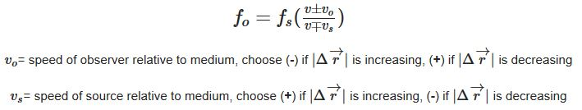
Doppler Shift

Slide 3
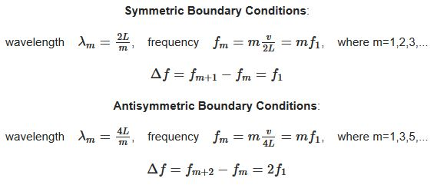
Standing Wave Resonance

Slide 4
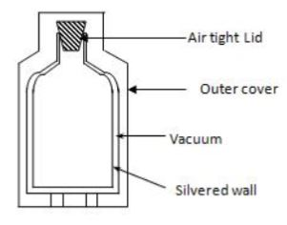
Question 1: 3 minutes
Thermoses are designed to minimize temperature changes of their contents. The figure shows a schematic of a thermos. Explain how the design addresses all three heat transfer mechanisms.

Slide 5
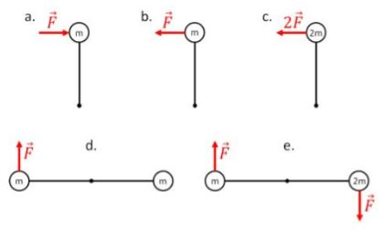
Question 2: 3 minutes
Rank the following angular accelerations from most negative to most positive, indicating if any are equal. Assume point masses at the end of massless rods.

Slide 6
Question 3: 3 minutes
The tires of a car support the weight of a stationary car. If one tire has a slow leak, the air pressure within the tire will _______ with time, the surface area between the tire and the road will _______ with time, and the net force the tire exerts on the road will _______ with time.
Decrease, increase, remain constant
Increase, decrease, remain constant
Decrease, increase, decrease
Decrease, decrease, decrease
Increase, increase, increase
Decrease, increase, increase

Slide 7
Question 4: 3 minutes
A 0.92m long pipe is closed on one end. It vibrates in the third harmonic with a frequency of 489Hz. In this situation, the speed of sound in air is closest to:
334 m/s
343 m/s
350 m/s
355 m/s
360 m/s

Slide 8
Question 5: 3 minutes
Which of the following characteristics of sound determine the “pitch” of a musical note? An example of a high pitch sound is a whistle, an example of a low pitch sound is a drum.
Amplitude
Wavelength
Frequency
Phase
Intensity

Slide 9
Problem 1: 7 minutes
A string, 5m long, is vibrating/resonating at its 4th harmonic. If there are 48 cycles in 20s, what is the frequency, period, wavelength, and velocity of the wave in the string?
If the string has a mass of 10g, what is the tension in the string?

Slide 10
Problem 2: 7 minutes
A train is traveling at 35m/s on a still air day. You are standing alongside the train track, stationary, as the conductor blares the 150Hz horn. What frequencies do you hear as the train approaches you, and then as it leaves past you?
What does the conductor on the train hear?

