Slide 1
PH202 Recitation 2
Torque, Statics, Dynamics

Slide 2
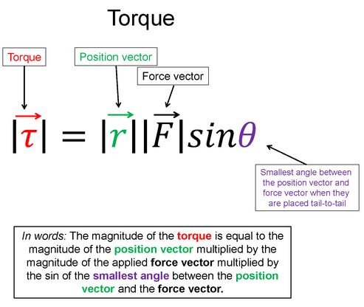
Warm-Up 1
Say the equation in words

Slide 3
Warm-Up 1 Solution

Slide 4
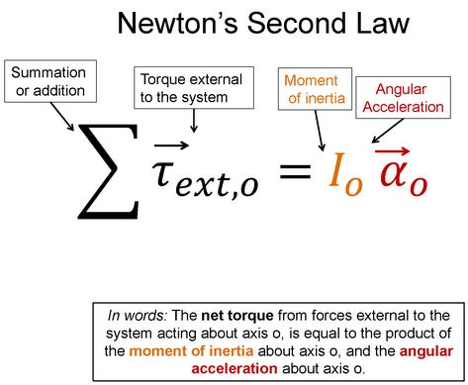
Warm-Up 2
Say this equation in words

Slide 5
Warm-Up 2 Solution

Slide 6
Discussion Question 1: 3 minutes
If you wish to stop a door from closing using a door stop that wedges between the floor and the bottom of the door, where should you place the door stop and why?

Slide 7
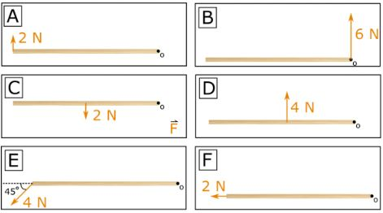
Discussion Question 2: 3 minutes
Consider a block of wood being pushed/pulled on by a force as shown in the images below. The images are drawn to scale. Rank the torques in each situation from most negative to most positive.

Slide 8
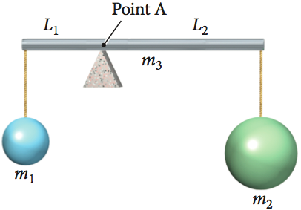
Discussion Question 3: 3 minutes
The rod below m₃ is balancing at rest on a pivot at point A, while holding up 2 masses m₁ and m₂ located lengths L₁ and L₂ away from point A respectively. If m₁= 8kg, L₁= 2m, and L₂= 4m, what is m₂? May not be drawn to scale.

Slide 9
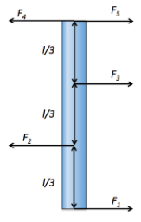
POTD: Read the Problem/Visualize: 2 minutes
Tuesday Statics: The massless rod pictured is in static equilibrium. The length of the rod is L and is divided into L/3 segments with forces acting perpendicular to the rod. If F₂= 6N, F₃= 3N, and F₄= 6N, what are F₁ and F₅?
Thursday Dynamics: Now have the same rod but the top of the rod is now bolted so that the rod rotates about the top. If all forces stay the same but F₂= 10N now, find the angular acceleration of the rod. Moment of Inertia for a rod about its end is I = 1/3 ML²

Slide 10
POTD: Picture, Knowns/Uknowns: 2 minutes
Tuesday Statics: The massless rod pictured is in static equilibrium. The length of the rod is L and is divided into L/3 segments with forces acting perpendicular to the rod. If F₂= 6N, F₃= 3N, and F₄= 6N, what are F₁ and F₅?
Thursday Dynamics: Now have the same rod but the top of the rod is now bolted so that the rod rotates about the top. If all forces stay the same but F₂= 10N now, find the angular acceleration of the rod. Moment of Inertia for a rod about its end is I = 1/3 ML²

Slide 11
POTD: Solve the Problem: 2 minutes
Tuesday Statics: The massless rod pictured is in static equilibrium. The length of the rod is L and is divided into L/3 segments with forces acting perpendicular to the rod. If F₂= 6N, F₃= 3N, and F₄= 6N, what are F₁ and F₅?
Thursday Dynamics: Now have the same rod but the top of the rod is now bolted so that the rod rotates about the top. If all forces stay the same but F₂= 10N now, find the angular acceleration of the rod. Moment of Inertia for a rod about its end is I = 1/3 ML²

Slide 12
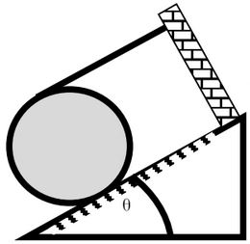
Challenge Homework Orientation
A 4kg disk lies in static equilibrium on an incline that makes an angle of 40 degrees up from the horizontal. A rope, parallel to the incline, connects the disk to an immovable wall. Through experiment it is found that the static friction between the disk and the incline is maximum. What is (a) the tension in the rope and (b) the coefficient of static friction between the disk and the incline?

