Slide 1
PH202 Recitation 4
Thermodynamics Part 1

Slide 2
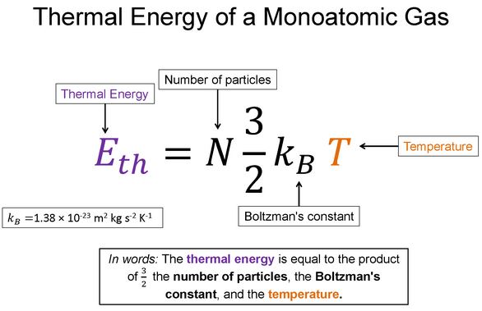
Warm-Up 1
Say the equation in words

Slide 3
Warm-Up 1 Solution

Slide 4
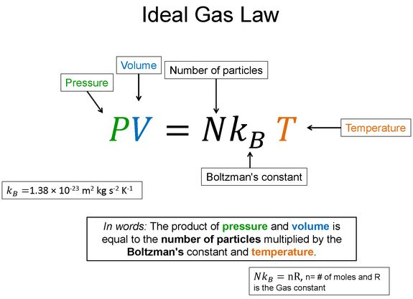
Warm-Up 2
Say this equation in words

Slide 5
Warm-Up 2 Solution

Slide 6
Discussion Question 1: 3 minutes
What is the average kinetic energy of a monoatomic gas molecule at 20°C?
What is the rms speed of a Helium (4g/mol) molecule at this temperature?

Slide 7
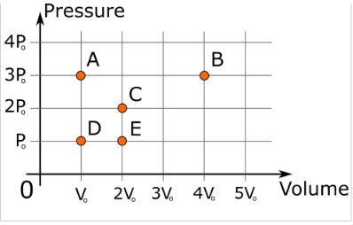
Discussion Question 2: 3 minutes
Each of the five points represent five different equilibrium states for a one mole of an ideal gas. Rank the temperatures of the different states.

Slide 8
Discussion Question 3: 3 minutes
An ideal gas is in a sealed container. By what factor does the gas pressure change if
The volume is doubled and the temperature is tripled?
The volume is halved and the temperature is tripled?

Slide 9
Discussion Question 4: 3 minutes
Calculate the number of molecules in a cubic meter of an ideal gas at standard temperature and pressure (STP). How many moles of gas is this?

Slide 10
Question 1: 7 minutes
I have 2 moles of a monatomic gas that is initially at a temperature of 500K. If 5000J of heat is added to the gas and the gas performs 7.5kJ of work, what is the final temperature of the gas?

Slide 11
Question 2: 7 minutes
Compute the internal energy change and temperature change for the 2 processes involving 1 mole of an ideal monatomic gas.
1500 J of heat are added to the gas and the gas does no work and no work is done on the gas
1500 J of work are done on the gas and the gas does no work and no heat is added or taken away from the gas

