Slide 1
PH202 Recitation 5
Thermo Part 2

Slide 2
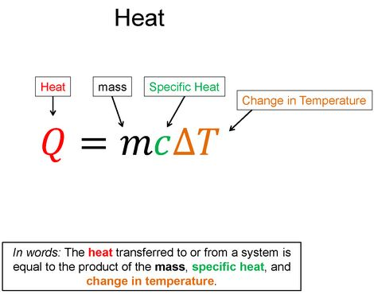
Warm-Up 1: 1 minute
Say the following equation in words

Slide 3
Warm-Up 1 Solution

Slide 4
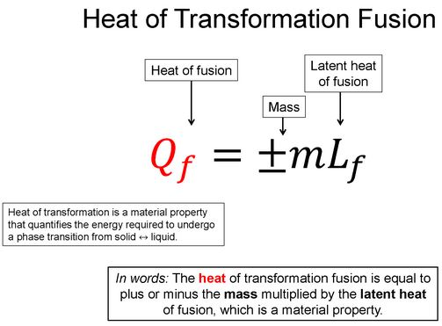
Warm-Up 2: 1 minute
Say the following equation in words

Slide 5
Warm-Up 2 Solution

Slide 6
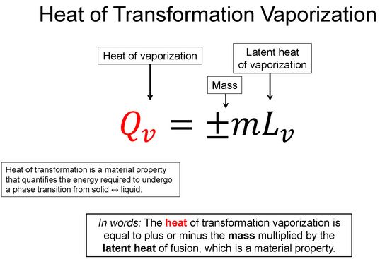
Warm-Up 3: 1 minute
Say the following equation in words

Slide 7
Warm-Up 3 Solution

Slide 8
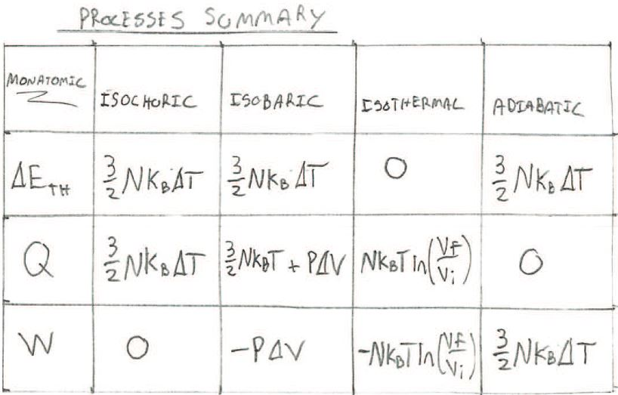
Warm-Up 4: 1 minute

Slide 9
Discussion Question 1: 3 minutes
Water is placed in a freezer and as it comes into thermal equilibrium it freezes. Which one of the following statements is true concerning this process?
The water gains entropy in accord with the second law of thermodynamics
The water loses entropy so the process violates the second law of thermodynamics
The water gains entropy, but the air inside the freezer loses entropy in accord with the second law of thermodynamics
Both the water and the air inside the freezer lose entropy, but the universe gains entropy in accord with the second law of thermodynamics
The water loses entropy, but the air inside the freezer gains entropy in accord with the second law of thermodynamics

Slide 10
Question 1: 7 minutes
I have a 0.500kg Aluminum pan with 0.250L of water in it. If I heat the system from 20°C to 120 °C , how much heat was required to do this? The specific heat of water is 4186 J/kg°C and the specific heat of Aluminum is 900 J/kg°C. The latent heat of water vaporization is 2260kJ/kg.

Slide 11
Question 2: 7 minutes
Sketch the following thermodynamic processes on a PV diagram and discuss how E_{th}, Q, and W for each of the processes.
Isochoric
Isobaric
Isothermal
Adiabatic

Slide 12
Challenge Homework Orientation
A 0.15-kg aluminum can contains 0.2 kg of water. Initially, the water and the can have a common temperature of 18 °C. An unknown material (m=0.04 kg) is heated to a temperature of 97 °C and then added to the water. The temperature of the water, the can, and the unknown material is 22 °C after thermal equilibrium is reestablished. Ignoring the small amount of heat gained by the thermometer, find the specific heat capacity of the unknown material.

