Slide 1
PH202 Recitation 6
Thermo Part 3 and Fluids

Slide 2
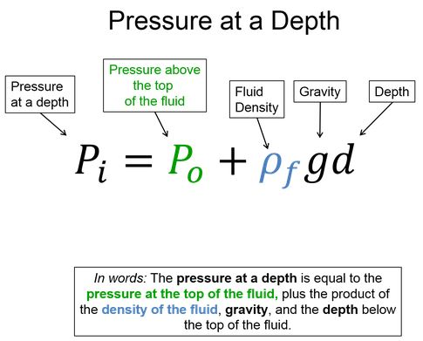
Warm-Up 1: 1 minute
Say the equation in words

Slide 3
Warm-Up 1 Solution

Slide 4
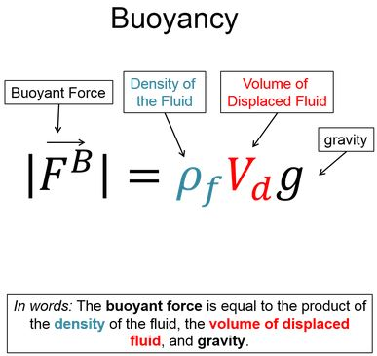
Warm-Up 2: 1 minute
Say the equation in words

Slide 5
Warm-Up 2 Solution

Slide 6
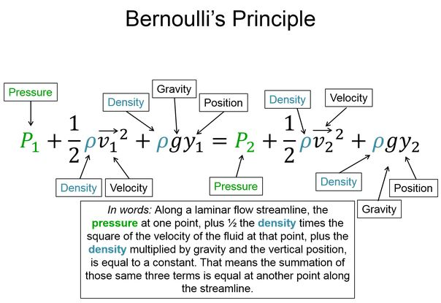
Warm-Up 3: 1 minute
Say the equation in words

Slide 7
Warm-Up 3 Solution

Slide 8
Question 1: 7 minutes
Calculate the depth of water needed to have a pressure of 1 atm.
What if it were mercury instead of water (density of mercury is 13,690kg/m³)?

Slide 9
Question 2: 7 minutes
Most IV infusions work using gravity. What is the minimum height that an IV bag must be placed above an entry point for the IV fluid to flow? Assume the bag is collapsible and that blood has a pressure of 18mm Hg and there is 133Pa per 1mm Hg.

Slide 10
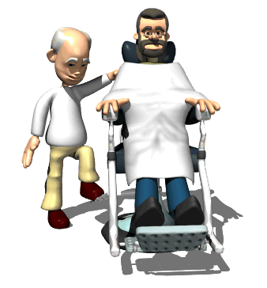
Question 3: 7 minutes
A barber raises a customer in a hydraulic chair. The barber uses a force of 150N on a piston that has an area of 0.01m². The chair is attached to a piston of area of 0.1m². If the mass of the chair is 5kg, what is the mass of the customer?

Slide 11
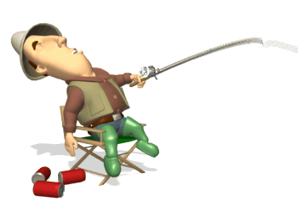
Question 4: 7 minutes
A fisherman with mass 75kg falls asleep on a chair (5kg). The chair has 4 legs on the ground with each leg having a radius of 2cm. What is the pressure exerted on the ground?

Slide 12
Question 5: 7 minutes
There is 1 mol of a monatomic ideal gas that is in a 4-step cycle. All processes are either isobaric or isochoric. The gas starts at a pressure of 100,000Pa and volume of 0.020m³. The pressure is then doubled isochorically. After that, the volume is then tripled isobarically. Then, the pressure is halved isochorically. Finally, the volume is then cut in to a third its value to get back to the original state.
Sketch the PV diagram
Determine the temperature at each point
Calculate W, Q, and ΔE for each step of the cycle and the whole cycle

