Slide 1
PH202 Recitation 8
SHM, Pendulums

Slide 2
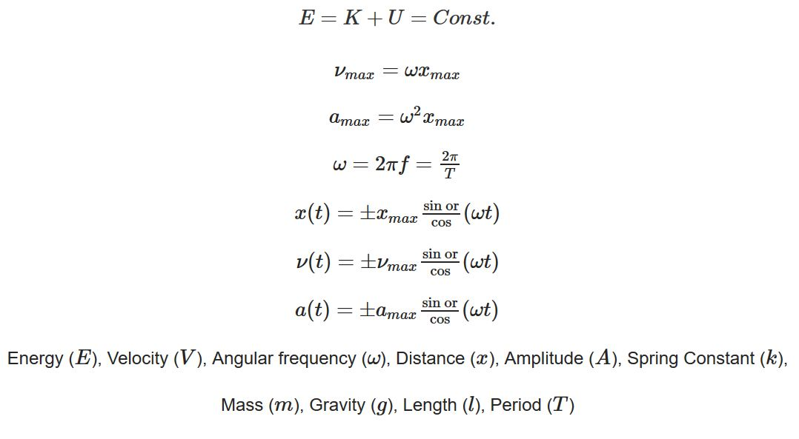
Equations for SHM

Slide 3
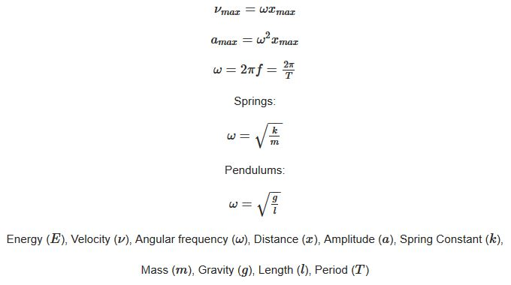
Equations for Pendulums/Springs

Slide 4
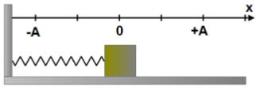
Discussion Question 1: 3 minutes
A mass in the diagram to the right undergoes simple harmonic motion. Use this diagram for the following 4 questions.
When the mass reaches point x = +A its instantaneous velocity is?
  Maximum and Positive
  Maximum and Negative
  Zero
  Less than maximum and positive
  Less than maximum and negative

Slide 5
Discussion Question 2: 3 minutes
When the mass reaches point x = 0 its instantaneous velocity is?
  Maximum and can be positive or negative
  Constant and doesn’t depend on the location
  Zero
  Slightly less than maximum and positive
  Slightly less than maximum and negative

Slide 6
Discussion Question 3: 3 minutes
When the mass reaches point x = +A its instantaneous acceleration is?
  Maximum and Positive
  Maximum and Negative
  Zero
  Slightly less than maximum and positive
  Slightly less than maximum and negative

Slide 7
Discussion Question 4: 3 minutes
When the mass reaches point x = 0 its instantaneous acceleration is?
  Maximum and Positive
  Maximum and Negative
  Zero
  Slightly less than maximum and positive
  Slightly less than maximum and negative

Slide 8
Problem 1: 5 minutes
There is a simple harmonic oscillator made up of a mass on a spring. If the mass is 0.015kg and the period of oscillation is 0.5s, what is the spring constant of the spring?
If the spring constant is doubled, how does the mass change in order to keep the frequency of oscillation constant?

Slide 9
Problem 2: 5 minutes
A 0.500kg mass is attached to a spring and oscillates with a period of T = 1.50s. How much mass must be added to the system in order to change the period to 2s?

Slide 10
Problem 3: 7 minutes
There is a pendulum made up of a rope and mass at the bottom. The rope has a length of 3m, the mass is 80kg, and the pendulum starts at a maximum angle of 30 degrees before being let go and entering oscillations. What is the tension in the rope at the bottom of the swing?

