Slide 1
PH202 Recitation 9
Waves and Energy

Slide 2
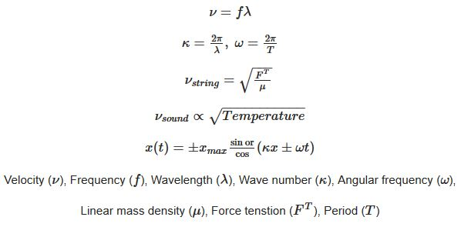
Equations

Slide 3
Question 1: 5 minutes
What is the velocity of an ocean wave if a sea gull bobs up and down and comes back to rest due to the wave in 5 seconds and the distance from crest to crest of the wave is 10m?
How long does it take the wave to travel 200km?

Slide 4
Question 2: 5 minutes
Humpback whales produce sounds at frequencies between 20Hz and 10kHz. If sound travels at 1400m/s in water
  Determine the range of wavelengths produced by the whales
  If these waves can travel up to 10000 miles, what is the range of amount of waves that can fit in that distance?

Slide 5
Question 3: 7 minutes
Waves in a swimming pool propagate at 0.750m/s. If it takes 30s to travel end to end and back, how far away is the end of the pool?
If the waves have an amplitude of 0.25m and 10 waves fit in the pool at a time, what is the equation of the wave?

Slide 6
Question 4: 7 minutes
A 12.0g bullet is fired into a 100g wooden block attached to a spring with a spring constant of 150N/m. The bullet embeds into the block and compresses the spring by 80cm. What was the speed of the bullet upon impact (muzzle velocity)?
Write the equation of motion for the spring once it starts oscillating.

