Slide 1
PH203 Week 8 Recitation
Kirchoff’s Law, Junction Rule, Equivalent Circuit

Slide 2
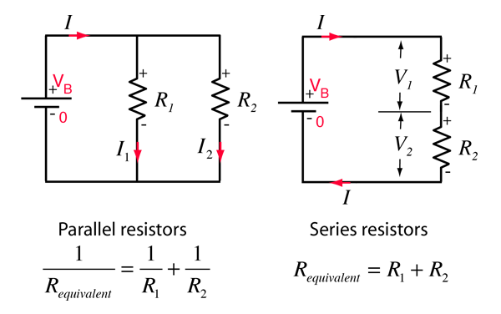
Equivalent Resistance:
Parallel & series arrangement

Slide 3
Kirchoff’s Law:
Kirchoff’s Voltage Loop Law (Conservation of energy)
Σv_{loop} = 0
Kirchoff’s junction rule
(Conservation of charge)
Σ I_{n} =Σ I_{out}
I
I₂
I₃
ΔV_{Battery} + ΔV_{R1} + ΔV_{R2} = 0
ε_{A} – (I*R₁)- (I*R₂) = 0
I= I₂+I₃

Slide 4
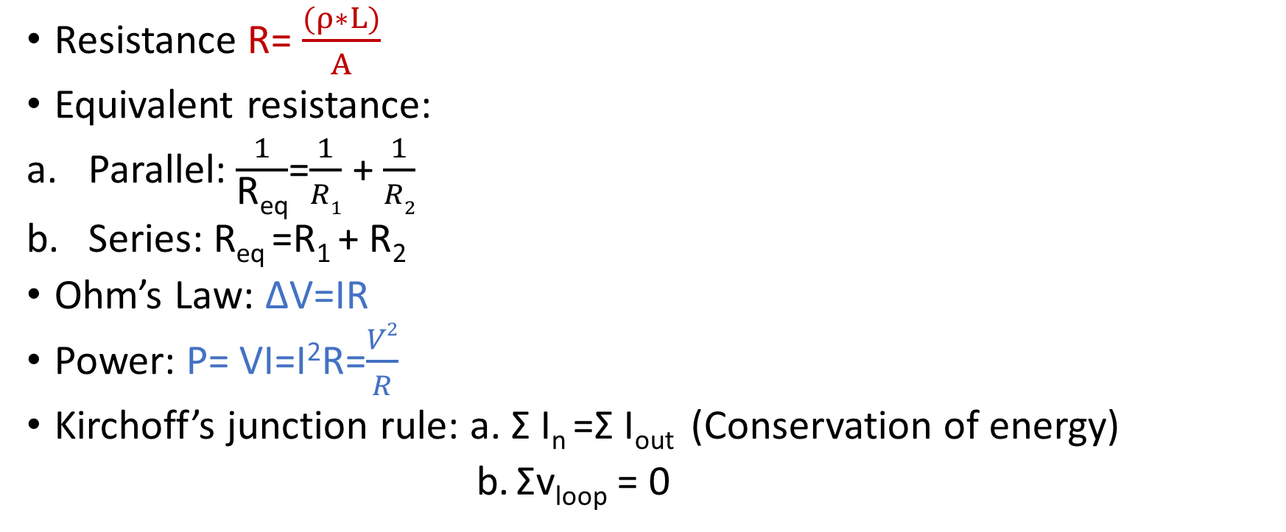
Formulae review on circuit:
Resistance R= $\frac{(ρ∗L)}{A}$
Equivalent resistance:
Parallel: $\frac{1}{\text{R}\text{eq}}$=$\frac{1}{R1}$ + $\frac{1}{R2}$
Series: R_{eq} =R₁ + R₂
Ohm’s Law: ΔV=IR
Power: P= VI=I²R=$\frac{V2}{R}$
Kirchoff’s junction rule: a. Σ I_{n} =Σ I_{out} (Conservation of energy)
b. Σv_{loop} = 0

Slide 5
Practice Question 1
Which of the following systems will cause the 2 resistor to dissipate 8 W.

Slide 6
Workspace

Slide 7
Practice Question 2
A circuit is constructed of six identical 4 Ohm resistors as shown. If the battery has a voltage of 9 V, how much current goes through resistor D?

Slide 8
Workspace

Slide 9
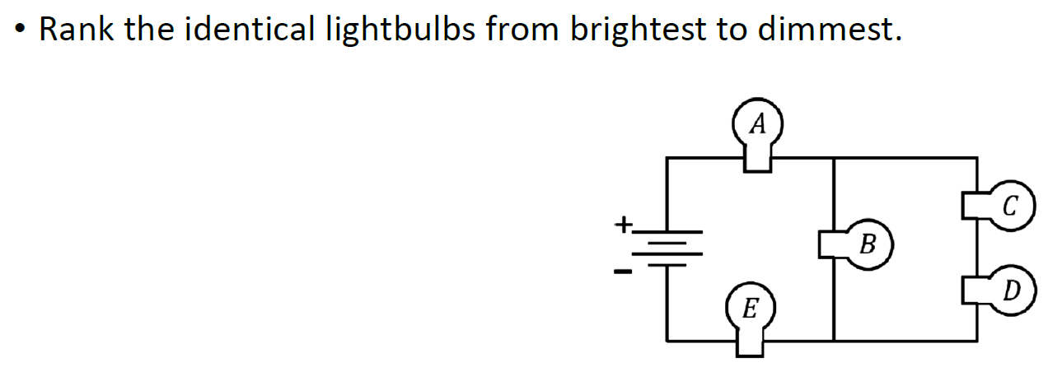
Practice Question 3

Slide 10
Workspace

Slide 11
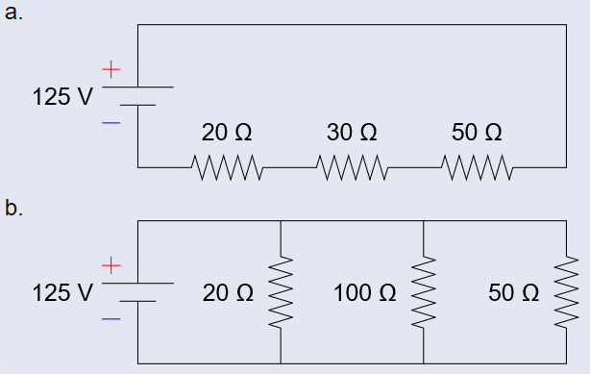
Problem of the Day
Determine the following quantities for each of the 2 circuits:
  Equivalent Resistance
  Total Current from power supply
  Current through each resistor
  Voltage drop across each resistor

Slide 12
Workspace

Slide 13
Practice Question 4 (Extra)
The following circuit has the speciﬁed voltages, currents, and resistances. Use Kirchhoﬀ’s loop rule to write an equation that describes the loop indicated by the bold circle and darker wires.

Slide 14
Workspace

Slide 15
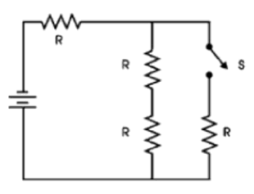
Practice Question 5 (Extra)
Consider the following circuit. Will more power be dissipated by the circuit when the switch S is open or closed?
  Open
  Closed
  No difference
With the switch S closed, what is the equivalent resistance of the circuit?
  4R
  2R/3
  2R
  5R/3
  5R/6
  R
  R/3
  R/2

Slide 16
Workspace

Slide 17
Challenge Question (Extra)
The current in the 8.00-Ω resistor in the drawing in 0.500 A.
(a) Find the current in the 20.0-Ω, 12.0-Ω, and both 9.0-Ω resistors.
(b) Find the voltage drop and indicate which point is at higher potential for following: between points G and F, A and B, A and E, and E and C.

Slide 18
Workspace

Slide 19
