Slide 1
PH203 Week 10 Recitation
Magnetic Flux, Faraday’s Law, Lenz’s Law

Slide 2
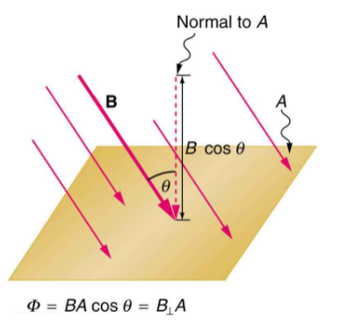

Magnetic Flux

Slide 3
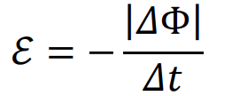
Faraday’s Law

Slide 4
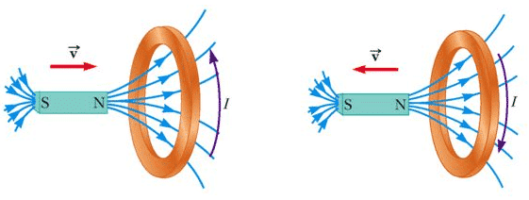
Lenz’s Law
A current can be induced in a closed wire only if the magnetic flux through the wire is changing. The direction of the induced current forces the resulting magnetic field to oppose the change in flux.

Slide 5
Induced Current Magnitude and Direction
The figure shows a triangle loop of wire in a uniform magnetic field. The area of the loop is 10 cm².
(a) If the strength changes from 0.30 to 0.10T in 50ms, what is the average induced emf in the loop?
(b) What is the direction of the induced current in the loop?

Slide 6
Work Space

Slide 7
Moving Rod
Consider the arrangement shown above. Conducting rod AB is lying on a U-shaped conductor, making good electrical contact. The arrangement is placed in a magnetic ﬁeld (into page). If the magnetic ﬁeld strength is decreased, the rod
a) remains stationary.
b) slides to the right.
c) slides to the left.
d) rotates clockwise.
e) moves up (out of page).
f) moves down (into page).
g) none of the above

Slide 8
Induced Current
A single-turn rectangular loop of width W and length L moves parallel to its length with a speed v. The loop moves from a region with a magnetic ﬁeld B perpendicular to the plane of the loop to a region where the magnetic ﬁeld is zero, as shown in the ﬁgure. Is the magnetic flux increasing, decreasing, or constant (a) before it enters the region of zero ﬁeld, (b) just after it enters the region of zero ﬁeld, and (c) once it is fully within the region of zero ﬁeld. (d) For each of the cases consider in parts (a), (b), and (c), state whether the induced current in the loop is clockwise, counterclockwise, or zero. Explain in each case.

Slide 9
Work Space

