Slide 1
PH203 Week 5 Recitation
Electric Fields

Slide 2
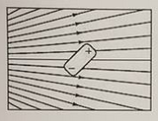
Warm-up 1
Consider the dipole in the non-uniform field shown below. What is the direction of the net force exerted on the dipole, and the net torque?

Slide 3
Warm up 2
A +5 micro coulomb charge resides in a constant electric field <-1, 3, 5> N/C. If the mass of the charge is 0.2 mg, what is the acceleration?

Slide 4
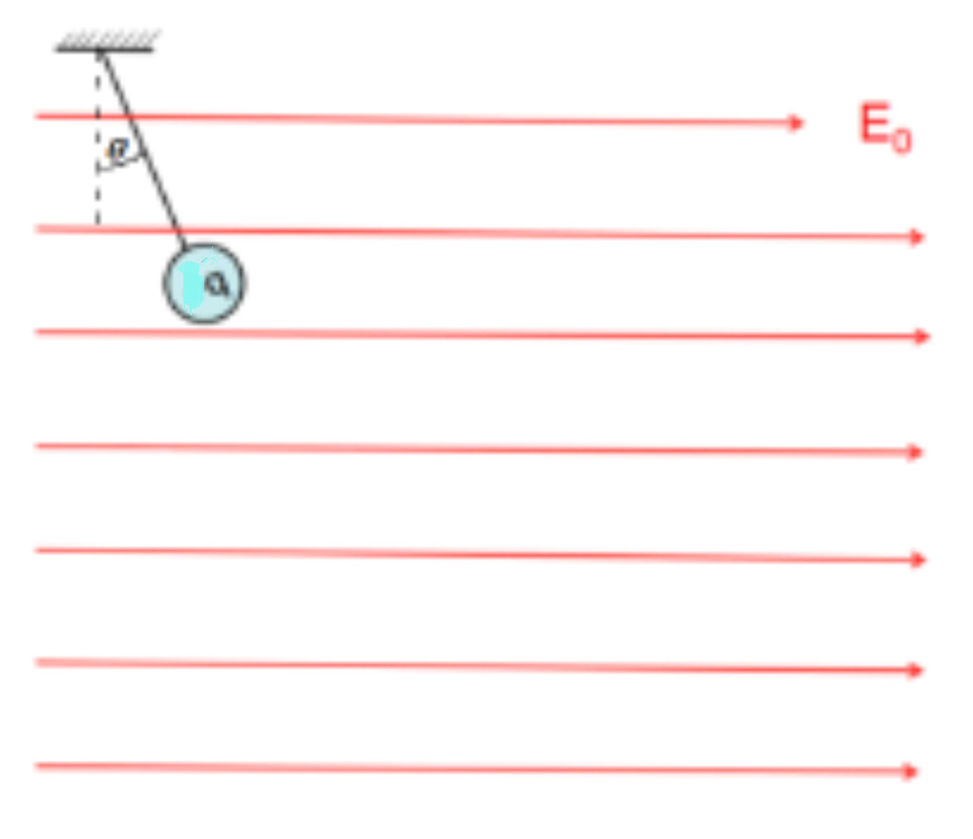
Charged Sphere
In the below diagram, a sphere with unknown charge q and mass 10 kg is subject to both a uniform electric ﬁeld (E₀ = 200 N/C) and Earth’s gravitational ﬁeld. The sphere is held in place by a string with tension. In equilibrium, the string makes an angle θ = 20◦ with respect to the vertical.
(a) Is the charge positive or negative?
(b) What is the value of the charge q on the sphere?
(c) If the string is cut, how far does the sphere move in 1.0 second?

Slide 5
Work Space

Slide 6
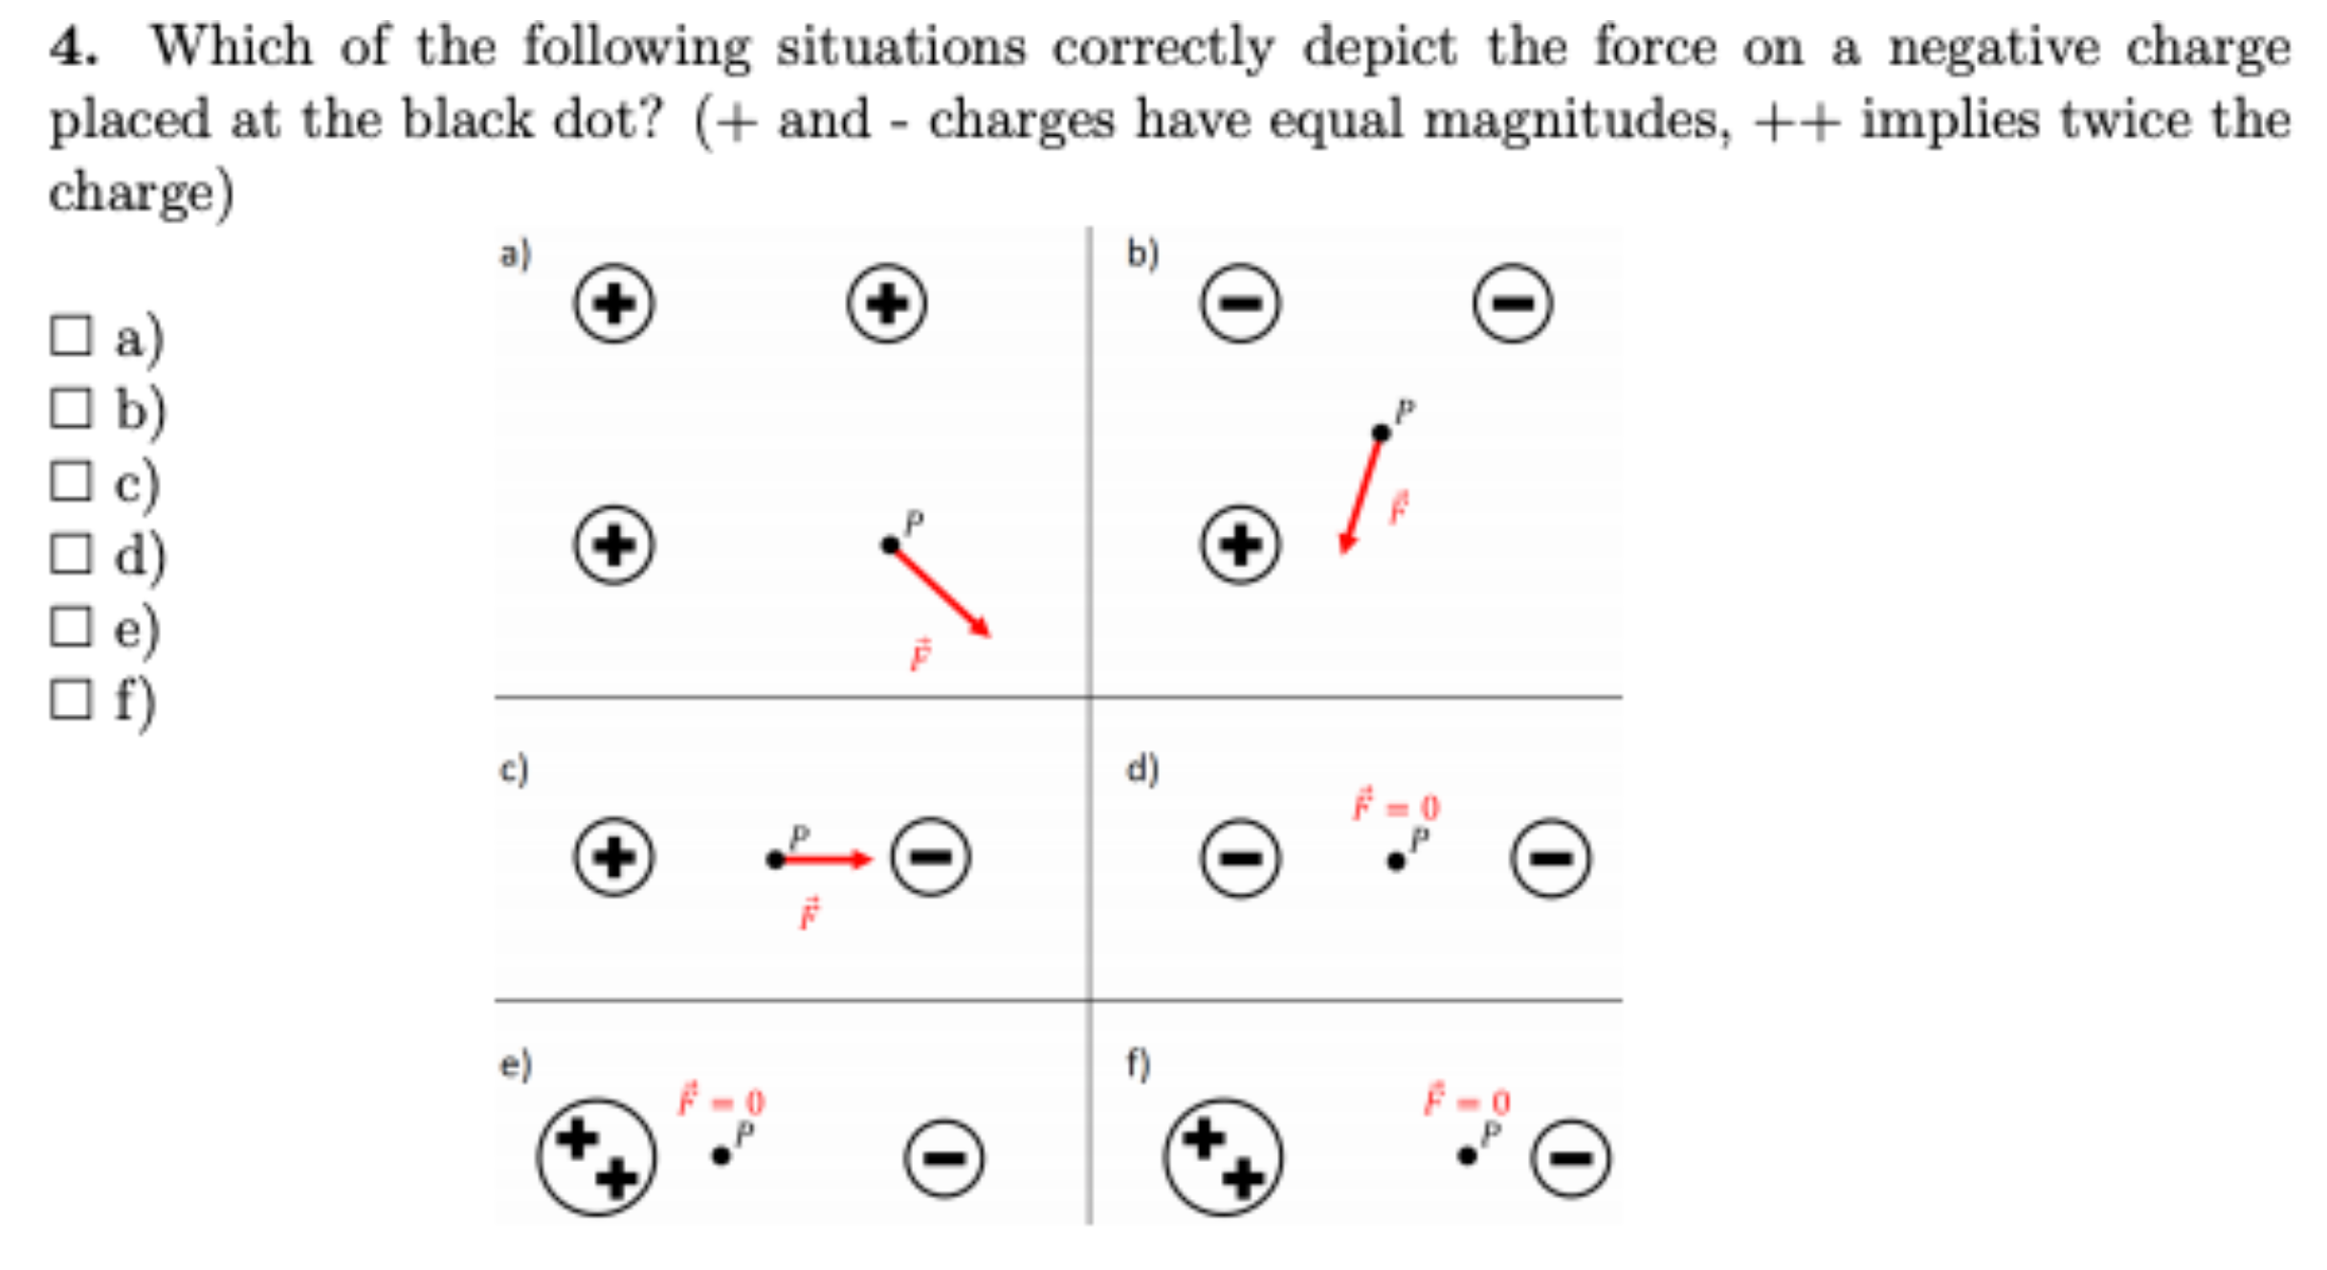

Slide 7
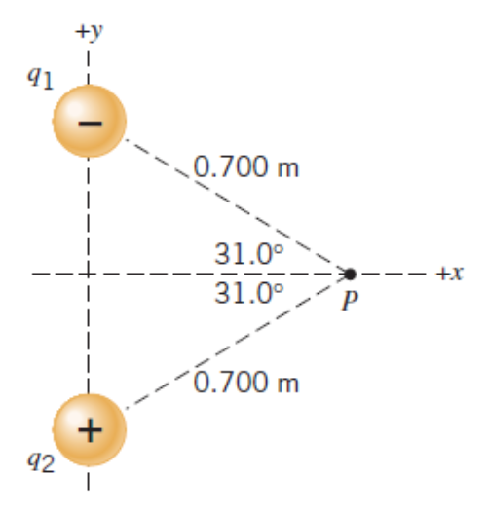
Two point charges are lying on the y-axis, with q1 = -4.00 µC and q2 = + 4.00 µC . They are equidistant from the point P, which lies on the x axis. What is the net electric field at point P?

Slide 8
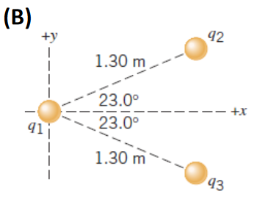
Two point charges are fixed in place. They have identical magnitudes but opposite signs: q2 = + 5.00 µC and q3 = - 5.00 µC. (a) Determine the electric field at the origin due to these charges. (b) If another point charge was placed at the origin with mass 1.50g and charge q1 = + 0.1 µC and it was free to move, what would be its acceleration?

